Slide 1
Sustainability Support for Education
MATs

Slide 2




Housekeeping
Please keep yourself on mute
Feel free to introduce yourself in the chat
Feel free to have your camera on or off
Put questions in the chat at any time
Notes:
Emily

Slide 3
Outline
United Learning and our sustainability journey
Overview of Sustainability Support for Education
How you can use the site to help your settings with climate action and develop CAPs
Demo: registration, selecting actions or aims, creating a list, sharing a list.
How you can use the site to support you in your role at your MAT
The sustainability journey
The unique challenges MATs face
Procurement

Slide 4
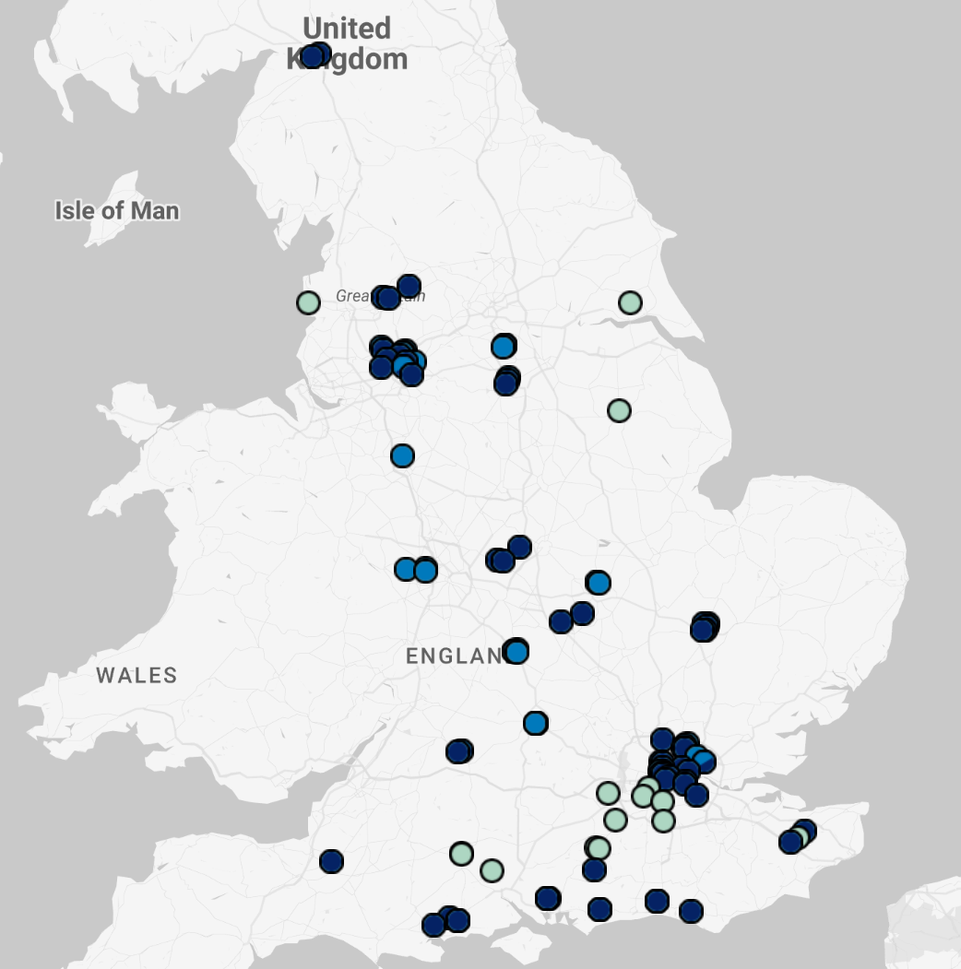
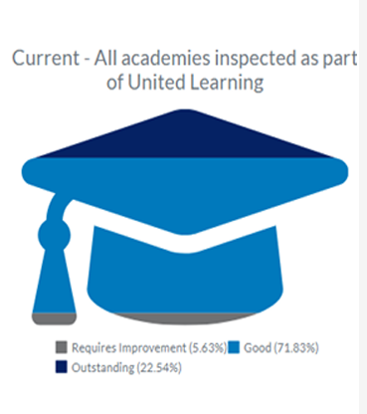
United Learning
Primary: 41
Secondary: 53
All‑through: 13
Nursery: 2
Academy: 94
Independent: 15

Slide 5
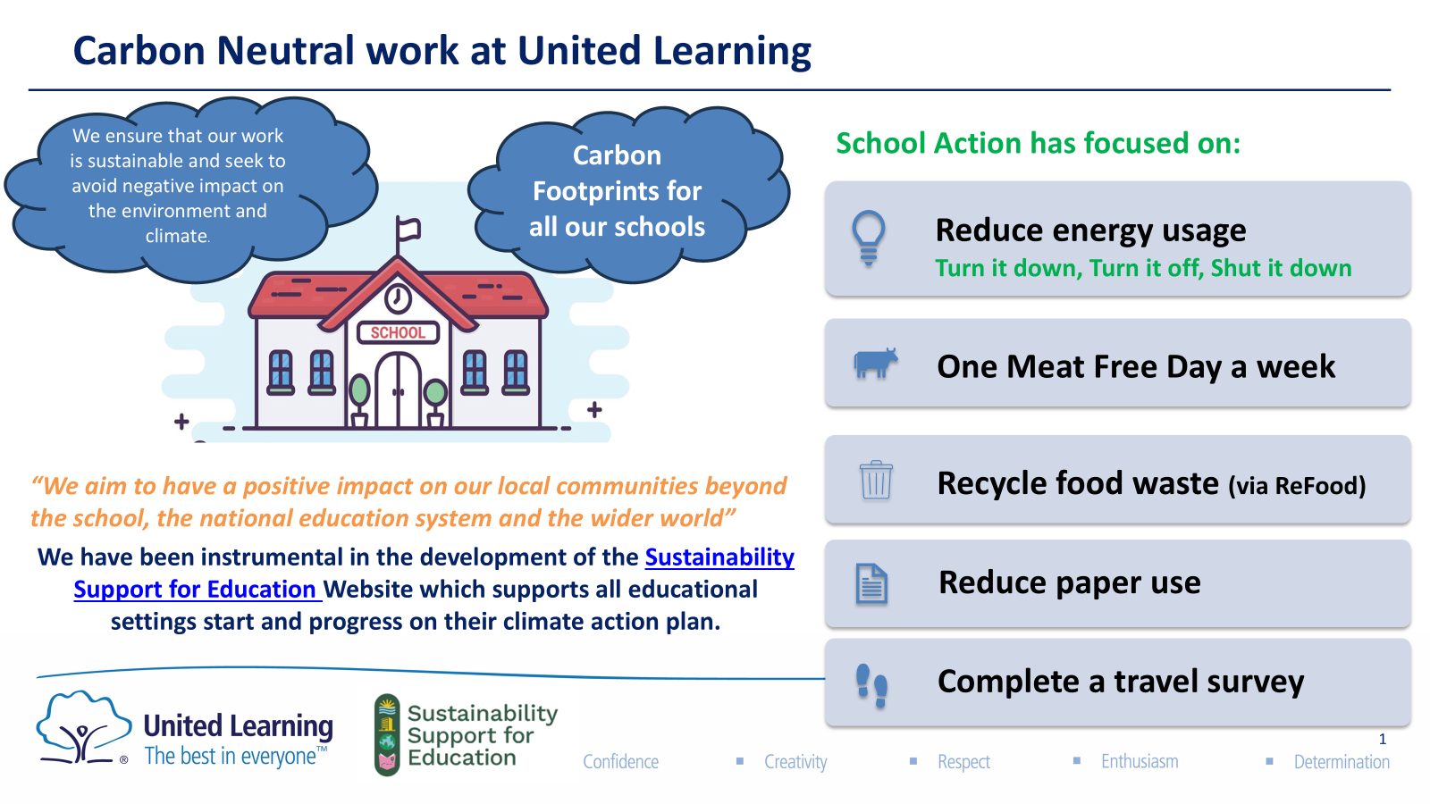

Slide 6
Lessons learnt from United Learning
We did a lot upfront to understand our starting point. We used a target to help focus our efforts and develop a strategy and roadmap around it.
Late success with PSDS. We didn’t jump straight into decarbonisation infrastructure projects and invest straight away in solar PV for example, even though this could have been considered a ‘no-brainer’.
When we started in 2019, the landscape was very different and there wasn’t as much support available as there is now.
For schools: In the last couple of years, we have focused our efforts on a select few areas. This has been really important and helpful in focusing our messaging and getting buy-in from those more reluctant.
We have focused more on operations and subsequently not prioritised the curriculum side of things. We really think there a big gains in procurement.
Despite doing this for 6 years, we still face the same challenges: buy-in from leadership, it feeling like ‘another thing’

Slide 7
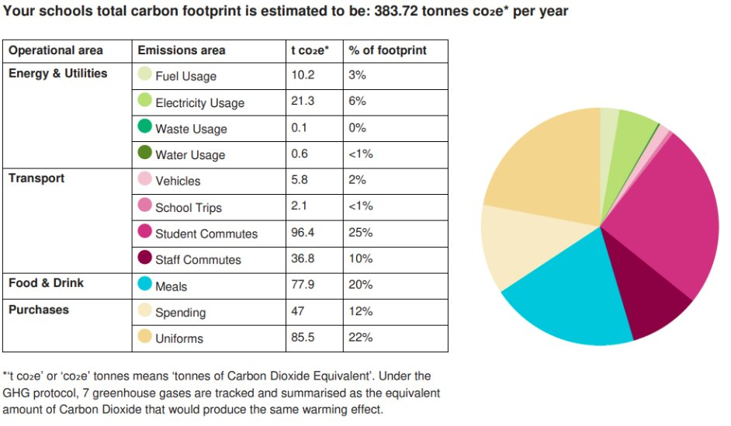
Taking Climate Action
What is Climate Action
Reduce emissions
Drive behavioural change and shifting mindsets
Developing resilience to the effects of an ever changing climate
Creating a better, greener world for future generations
Enhancing our natural surroundings
Increasing access to, and connection with nature
Notes:
Lizzie
This guide supports those working with education settings to develop climate action plans and advance sustainability efforts. It highlights key site features and offers suggestions for using them effectively. The site provides various tools for both Climate Ambassadors and settings, which are explored in this document. Since every setting is different, these are flexible suggestions—you may discover other useful approaches, and we’d love to hear about them!
This guide is for individuals working with education settings, supporting them to develop their climate action plans, and make progress more broadly on their sustainability journey.
It provides suggestions on how to get the best out of the site for that purpose, by sharing details of some aspects of functionality available on the site and making suggestions as to how you might use them to interact with educational settings.
The site has a range of ways that it can be used by both yourself as a Climate Ambassador to support a setting and by a setting to progress on its sustainability journey, which will be explored in this document.
We recognise that you will work with settings in lots of different ways, so these are intended to be a range of suggestions. You may find many other ways to use it, and we'd be interested to hear those!

Slide 8
Taking Climate Action
DfE want all schools (and groups) to have one. Depending on your size, you may choose to have one for your whole group, or one for each school.
We all need to take action towards a more sustainable future.
It's a tool to create focus for your activity and to bring your colleagues with you.
Help you create a vision to drive ambition and realise your goals
Evidence shows that taking climate action will have lots of wider benefits for your setting such as:
financial savings from energy efficiency;
mental health and wellbeing through outdoor learning;
improving the school infrastructure and estate.
A whole-institution approach to sustainability can effectively demonstrate compliance with various aspects of the Education inspection Framework.
Why have a Climate Action Plan
Notes:
POLL: What approach are you taking with CAPs?
We will have one for the group/trust.
Each of our schools will have one.
We have not decided yet.
This guide supports those working with education settings to develop climate action plans and advance sustainability efforts. It highlights key site features and offers suggestions for using them effectively. The site provides various tools for both Climate Ambassadors and settings, which are explored in this document. Since every setting is different, these are flexible suggestions—you may discover other useful approaches, and we’d love to hear about them!
This guide is for individuals working with education settings, supporting them to develop their climate action plans, and make progress more broadly on their sustainability journey.
It provides suggestions on how to get the best out of the site for that purpose, by sharing details of some aspects of functionality available on the site and making suggestions as to how you might use them to interact with educational settings.
The site has a range of ways that it can be used by both yourself as a Climate Ambassador to support a setting and by a setting to progress on its sustainability journey, which will be explored in this document.
We recognise that you will work with settings in lots of different ways, so these are intended to be a range of suggestions. You may find many other ways to use it, and we'd be interested to hear those!

Slide 9



Sustainability Support for Education
Your free online expert-backed Climate Action Hub​
A fast, easy, and high-quality platform to help every education setting build their Climate Action Plans: ​ ✔ Quick – Built for busy staff​ ✔ Simple – Everything in one place​ ✔ Trusted – The very best resources, expert-checked​ ​
Start and progress on your sustainability journey today – all in this one stop shop.
Notes:
Lizzie

Slide 10

Notes:
Lizzie
Registration, adding multiple settings to your account, selecting actions or aims, creating a list, sharing a list.

Slide 11
Register on the site

Slide 12
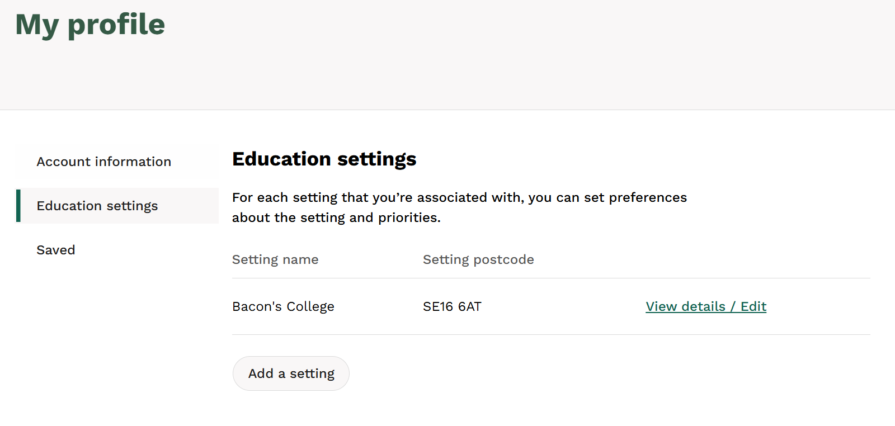
Adding multiple settings to your account
If you are in a small MAT, you can register as one user and add all the settings to your account.
HOW: Once you have added a setting to your account, you can add multiple settings. This needs to be done manually by clicking on ‘Add a setting’.
For larger MATs, we don’t recommend this and we can provide you with the data on which schools in your group have signed up.
1
Notes:
Lizzie
POLL: How many schools are in your group/MAT?
Under 5
Less than 15
More than 15

Slide 13
Advising your settings on Actions
Selecting Appropriate Actions
Consider what progress has already been made
Your unique context and scale
Your approach to autonomy vs steering your schools
Be ambitious but realistic
Be guided by the sequenced steps on the site
Ask for help when needed - draw on use in person support from the Climate Ambassadors or Lets Go Zero Climate Action Advisors
Notes:
Lizzie

Slide 14
Your phase and your setting
Early Years: Focus on outdoor learning and improving wellbeing and connection to nature.
Promote the benefits of using outdoor learning spaces to your stakeholders
Introduce outdoor activities as part of learning
First 10 actions for an EY setting HERE.
Primaries: Focus on building the groundwork.
Assess the current sustainability position of your setting
Understand what data is available across all areas of sustainability
Consult your community on creating sustainability aspirations
Identify your sustainability priorities
Agree a sustainability vision
Start to build a whole-setting awareness of sustainability
View Primaries Suggestions List HERE.
Secondaries: Focus on taking the first steps.
Create a sustainability working group
Appoint a sustainability focussed governor
Understand your energy use
Understand how people travel to your setting
Conduct a waste audit.
View Secondaries Suggestions List HERE.
Notes:
Lizzie

Slide 15
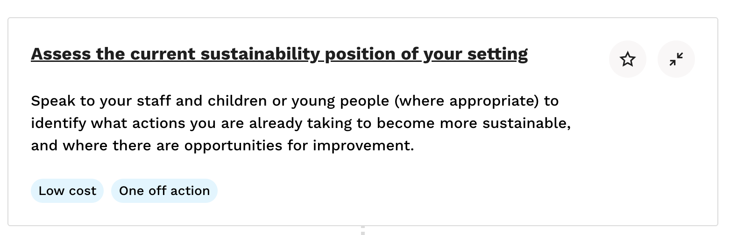
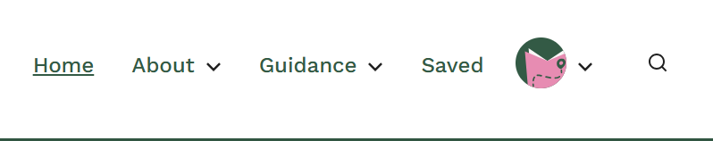
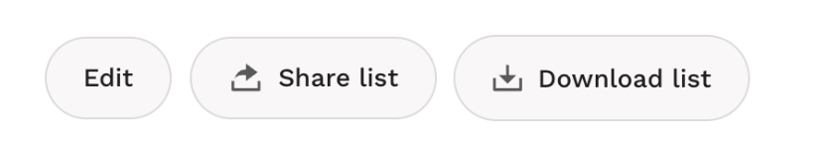
Create lists
Why create and share lists with your settings?
Save actions to a list to prioritise and return to later.
Your settings can use the lists you create to form the foundation of a Climate Action Plan.
Create lists for your settings to maximise the support you can give and save them time.
We have created a number of these suggested lists.
1
2
3
Notes:
Lizzie

Slide 16
Lists to share with your settings
Choose the ones that are relevant to you and share them with your settings:
‘My settings are just getting started and need to do some planning to develop the building blocks for success’
‘My settings have made some good progress but they’re struggling to get senior leadership buy-in’
‘School grounds and biodiversity are important to my settings, get them started on improving it’
‘Cost savings are an important driver for my group and my settings for climate action. Help me take the next steps’.
‘Community engagement is a motivating driver for my settings. What climate action can I take in this vein?’
Notes:
Lizzie

Slide 17
How Sustainability Support for Education can support you in your role at your MAT
Using the Sustainability Journey and Maturity Matrix to be strategic
Solving the particular challenges we face as Trusts
Notes:
Emily

Slide 18
Foundations of the site
Department for Education Strategy Pillars
The actions you will find on the site are based on increasing maturity as you progress on your Sustainability Journey
Sustainability Fundamentals
Decarbonisation and Energy Efficiency
Climate Adaptation and Resilience
Biodiversity and Green Infrastructure
Climate Education, Green Skills and Careers
1
Setting the groundwork
2
Taking the first steps
3
Sustainability Support for Education
Maturity Stages
Developing your practice
4
Learning to Lead
5
Advanced actions
Notes:
Guidance is written for the site
Resources are publicly sources
-explain the difference between the two and then provide all the definitions

Slide 19
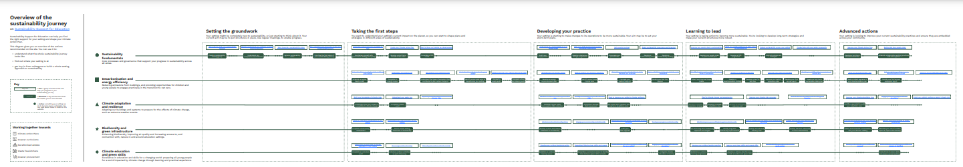
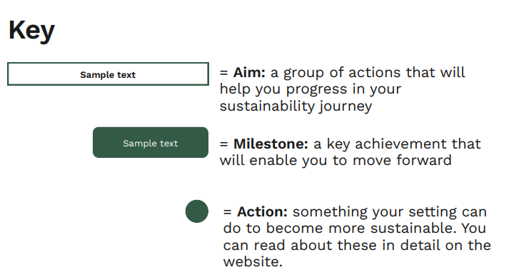
The sustainability journey
Notes:
Reflect the fact everyone is at a different stage and its likely that each setting will be at a different stage of their journey in each pillar eg they might be at level 1 (name) for decarb but level 0 for bio

Slide 20
The sustainability journey
Getting the most from the sustainability journey
Familiarise yourself with the key characteristics of each stage.
Use the visual as a diagnostic tool to determine where you think you are as a group or some of your schools are on their sustainability journey.
Use this as a guide as to which actions might be appropriate to focus on next. Locate these on the site and share the actions with your settings.
You may use it to decide to prioritise one or two pillars.
Talk to your settings about their journey and engage them in your group’s broader journey.
Use this guide to show how much progress you’ve made and celebrate the success of your settings and group!
Notes:
Reflect the fact everyone is at a different stage and its likely that each setting will be at a different stage of their journey in each pillar eg they might be at level 1 (name) for decarb but level 0 for bio

Slide 21
The sustainability journey
At United Learning, as a Trust, we would probably place ourselves along the maturity matrix at ‘Learning to Lead’. However some of our schools sit either side of that. We are using this journey to plot out what comes next and help us think strategically about our progress towards our target.
Case Study
Majority of our schools are in this range
Some of our trailblazer schools are here!
Where we are as a Trust
Notes:
Reflect the fact everyone is at a different stage and its likely that each setting will be at a different stage of their journey in each pillar eg they might be at level 1 (name) for decarb but level 0 for bio

Slide 22
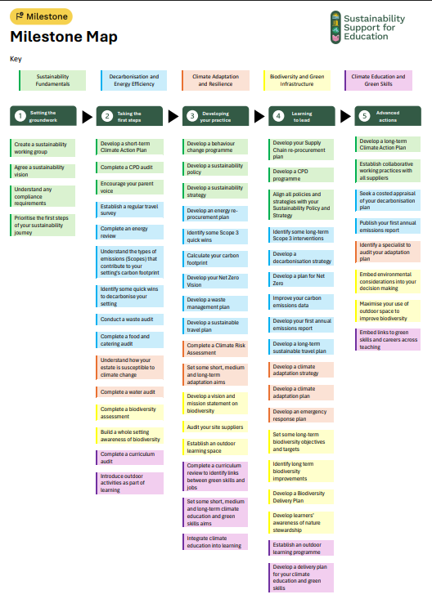
Visualising the journey
Coming soon!

Slide 23
Things to get you started as a MAT
Insights from CST Webinar:
38% of trusts have measured their full carbon footprint (Scopes 1, 2, and 3) at least once in the past three years
18% do so annually
62% have not measured their footprint at all. 23% of which have no plans to do so.
‘I want to understand my starting point and do a MAT level Carbon Footprint assessment’ This will save your settings time in doing individual assessments, and you may hold lots of the data centrally.
Notes:
POLL: Have you done a carbon footprint?
Yes, group wide.
Some of my schools have got one.
No not at all

Slide 24
Overcoming barriers
Insights from CST Webinar: Barriers to progress are multifaceted
The most cited obstacle was 'competing priorities' (33%), followed closely by 'lack of time or staff capacity' (28%) and 'lack of funding' (23%). These responses reflect the operational pressures trusts face, where sustainability efforts often compete with immediate educational and financial demands.
Help me find funding opportunities to support decarbonisation works across my settings and help me apply for them.
Help me carve out some capacity, make the most of it and set some priorities.

Slide 25
Developing data literacy
Insights from GSI
GSI data shows on utility data and tracking, while 74% and 47% of schools track energy and water usage respectively, only 33% and 7% had actually set reduction targets.
I’m looking to improve the sustainability related data my setting has, and use this to drive insights for action
I want to understand more about the potential for decarbonisation across my settings, and need help to commission decarbonisation surveys.
I’m looking for all the best audits.
Notes:
The lack of foundational data management frameworks is a critical barrier to effective planning and progress. The gaps between measurement and action perhaps also highlights a broader issue that schools are beginning to gather data, but many lack the capacity or support to translate useful data into strategic initiatives.

Slide 26
Procurement: Untapped potential
‘I want to start tackling Scope 3 emissions. Where do I start?’
Procurement topic
Insights from CST Webinar
Sustainable procurement - a key lever for reducing Scope 3 emissions—has seen limited adoption. Just 8% of trusts have embedded these practices across most departments, with 38% having done so in some areas. Another 38% are planning to implement such initiatives, suggesting potential for growth if supported by clear guidance, training and funding. However, 16% have yet to begin, highlighting the need for effective sector-wide frameworks and incentives.

Slide 27
Encouraging collaboration in Groups
A whole-institution approach to sustainability is essential to driving long term climate action. This applies to within a setting and within Groups. We know that communicating plans and activity is important to you and we encourage this behaviour on the site.
There are a number of specific actions that highlight this, for example:
Collaborate on sustainability in your group
Collaborate with your group on climate risk assessment and management
Share your Climate Action Plan with stakeholders

Slide 28
Feedback

